Slide 1
R for Mixed-effects models
Paul Bliese

Slide 2
Purpose
Discuss challenges and opportunities analyzing nested data using mixed-effect model functions in R
Nested Data
Longitudinal (Panel) Data

Slide 3
Disclaimer
By necessity, I provide a high-level overview
Numerous books and resources exist for estimating mixed-effect models (just a few below)
Bliese, P. D. (2016). Multilevel Modeling in R: A Brief Introduction to R, the Multilevel Package, and the nlme package (version 2.6). https://cran.r-project.org/doc/contrib/Bliese_Multilevel.pdf
Hox, J. J., Moerbeek, M., & van de Schoot, R. (2010). Multilevel analysis: Techniques and applications. Routledge.
Littel, R.C., Milliken, G.A., Stroup, W.W., and Wolfinger, R.D. (1996). SAS Systems for Mixed Models, SAS Institute.
Pinheiro, J.C., and Bates, D.M. (2000) Mixed-Effects Models in S and S-PLUS, Springer.
Raudenbush, S. W., & Bryk, A. S. (2002). Hierarchical linear models: Applications and data analysis methods. Sage.
Singer, J. D., & Willett, J. B. (2003). Applied longitudinal data analysis: Modeling change and event occurrence. New York, NY: Oxford University Press.

Slide 4
Outline
Brief introduction to R and mixed-effect packages
Background on nested data and non-independence
Mixed-effects models for nested data
Examples of longitudinal (panel) data
Mixed-effects models for longitudinal data
Growth Model
Discontinuous Growth Model

Slide 5
Introduction to R
R is an open-source program (https://cran.r-project.org/)
R-Studio is an integrative program with a code editor, debugging and visualization tools useful for teaching (https://www.rstudio.com/)
Features
Effective data handling and storage
A large collection of tools for data analysis
A well-developed and concise programming language
Graphical facilities for data analysis and display

Slide 6

Introduction to R
New York Times: January 6, 2009

Slide 7
Introduction to R
Packages
Functions
Help Files
Example Data
Base
Working
Environment
[Users data, results,
and functions]
>objects()
nlme
>library(nlme)
multilevel
>library(multilevel)
foreign
>library(foreign)

Slide 8
Introduction to R
For mixed-effects models, I will primarily discuss two packages.
multilevel 2.6 (Bliese, 2016)
Functions of interest to Organizational Researchers
Functions to manipulate data
nlme (Pinheiro and Bates, 2000)
Mixed Effects Models for Multilevel Modeling and Growth Modeling
I may occasionally refer to
lme4 (Bates, Maechler, Bolker, & Walker, 2015)
Other packages available (e.g., glmmML, glmmTMB – in development)

Slide 9
Background on Nested Data
Many large datasets have some form of non-independence
Individuals are members of groups (e.g., squads, platoons, families, departments, firms, geographic areas) and group membership influences individual responses
Non-independence is typically indexed by the Intraclass Correlation Coefficient (ICC) also known as the ICC(1)
Data and R code (to follow examples)
> library(multilevel)
> data(bh1996) #move data from library to workspace

Slide 10
Background on Nested Data
> bh1996[c(1:5,101:105,201:205),c("GRP","HRS","LEAD")]
GRP HRS LEAD
1 1 12 3.181818
2 1 11 3.000000
3 1 12 3.636364
4 1 9 3.363636
5 1 7 3.545455
101 2 10 2.090909
102 2 15 1.909091
103 2 12 3.636364
104 2 12 2.636364
105 2 12 3.181818
201 3 10 4.181818
202 3 10 3.545455
203 3 8 3.818182
204 3 8 2.272727
205 3 10 3.727273
Data Structure

Slide 11
Background on Nested Data
Use graph.ran.mean() to visualize ICC(1) values
non-independence – also just referred to as ICC
> tmod<-aov(HRS~as.factor(GRP),data=bh1996)
> ICC1(tmod)
[1] 0.1331067
> par(bg="transparent") #helpful with RStudio
> with(bh1996,graph.ran.mean(HRS,GRP,nreps=1000,
bootci=TRUE))

Slide 12
Background on Nested Data
An ICC(1) value of .13 (Work Hours)

Slide 13
Background on Nested Data
Visualizing another ICC(1): Leadership
> tmod<-aov(LEAD~as.factor(GRP),data=bh1996)
> ICC1(tmod)
[1] 0.1270276
> with(bh1996,graph.ran.mean(LEAD,GRP,nreps=1000,
bootci=TRUE))

Slide 14
Background on Nested Data
An ICC(1) value of .13 (Leadership)

Slide 15
Background on Nested Data
What if we were trying to predict individual’s perceptions of leadership from individuals reports of work hours?
Individual reports of work hours negatively related to views of leaders
Non-independence would be a problem
Parameter estimates (my focus here)
Standard Errors (see Bliese & Hanges, 2004)
Numerous ways to fix the problems:
Fixed-effect OLS models
Generalized Estimation Equations (gee) [Not discussed here]
Mixed-Effects models

Slide 16
Background on Nested Data
Ordinary Least Squares (OLS) Regression (biased)
Fixed-Effect Fix (OLS) Regression (unbiased)
> tmod<-lm(LEAD~HRS,data=bh1996)
> round(summary(tmod)$coef,dig=4)
Estimate Std. Error t value Pr(>|t|)
(Intercept) 3.4072 0.0452 75.4557 0
HRS -0.0457 0.0039 -11.6679 0
> tmod<-lm(LEAD~HRS+as.factor(GRP),data=bh1996)
> round(summary(tmod)$coef[1:2,],dig=4)
Estimate Std. Error t value Pr(>|t|)
(Intercept) 3.3317 0.0941 35.4019 0
HRS -0.0367 0.0040 -9.2378 0

Slide 17
Background on Nested Data
Fixed effect regression is “expensive”: Estimation / DF
> system.time(tmod<-lm(LEAD~HRS,data=bh1996))
user system elapsed
0 0 0
> system.time(tmod<-lm(LEAD~HRS+as.factor(GRP),data=bh1996))
user system elapsed
0.12 0.00 0.12
> round(summary(tmod)$coef,dig=4) #Lots more GRPS not shown
Estimate Std. Error t value Pr(>|t|)
(Intercept) 3.3317 0.0941 35.4019 0.0000
HRS -0.0367 0.0040 -9.2378 0.0000
as.factor(GRP)2 -0.3995 0.1231 -3.2455 0.0012
as.factor(GRP)3 -0.0163 0.1110 -0.1467 0.8833
as.factor(GRP)4 -0.1445 0.1387 -1.0417 0.2976
as.factor(GRP)5 0.2034 0.1096 1.8553 0.0636
as.factor(GRP)6 -0.0969 0.1592 -0.6087 0.5427
as.factor(GRP)7 -0.3772 0.1572 -2.3995 0.0164
....

Slide 18
Background on Nested Data
Fixed-Effect Fix (OLS): "gold-standard" here
Mixed-Effect Model: Good here, but easily Improved
> tmod<-lm(LEAD~HRS+as.factor(GRP),data=bh1996)
> round(summary(tmod)$coef[1:2,],dig=4)
Estimate Std. Error t value Pr(>|t|)
(Intercept) 3.3317 0.0941 35.4019 0
HRS -0.0367 0.0040 -9.2378 0
> library(nlme)
> tmod<-lme(LEAD~HRS,random=~1|GRP,data=bh1996)
> round(summary(tmod)$tTable,dig=4)
Value Std.Error DF t-value p-value
(Intercept) 3.3208 0.0542 7282 61.2921 0
HRS -0.0381 0.0039 7282 -9.6474 0

Slide 19
Background on Mixed-Effects Models
Fixed-Effect Fix (OLS): "gold-standard" here
Mixed-Effect Model (group-mean centered)
> tmod<-lm(LEAD~HRS+as.factor(GRP),data=bh1996)
> round(summary(tmod)$coef[1:2,],dig=4)
Estimate Std. Error t value Pr(>|t|)
(Intercept) 3.3317 0.0941 35.4019 0
HRS -0.0367 0.0040 -9.2378 0
> tmod<-lme(LEAD~W.HRS,random=~1|GRP,data=bh1996)
> round(summary(tmod)$tTable,dig=4)
Value Std.Error DF t-value p-value
(Intercept) 2.8885 0.0316 7282 91.2764 0
W.HRS -0.0367 0.0040 7282 -9.2372 0

Slide 20
Background on Mixed-Effects Models
Fixed-Effect Fix (OLS): "gold-standard" here
Another Mixed-Effect Model (Add group-mean)
> tmod<-lm(LEAD~HRS+as.factor(GRP),data=bh1996)
> round(summary(tmod)$coef[1:2,],dig=4)
Estimate Std. Error t value Pr(>|t|)
(Intercept) 3.3317 0.0941 35.4019 0
HRS -0.0367 0.0040 -9.2378 0
> tmod<-lme(LEAD~HRS+G.HRS,random=~1|GRP,data=bh1996)
> round(summary(tmod)$tTable,dig=4)
Value Std.Error DF t-value p-value
(Intercept) 4.5888 0.3882 7282 11.8193 0.0000
HRS -0.0367 0.0040 7282 -9.2378 0.0000
G.HRS -0.1131 0.0343 97 -3.2939 0.0014

Slide 21
Background on Mixed-Effects Models
Mixed-effect models account for groups using 1 DF
> VarCorr(tmod) # from nlme
GRP = pdLogChol(1)
Variance StdDev
(Intercept) 0.08296611 0.2880384
Residual 0.51494780 0.7175986
> system.time(tmod<-lm(LEAD~HRS+as.factor(GRP),data=bh1996))
user system elapsed
0.14 0.00 0.14
# nlme library (older)
> system.time(tmod<-lme(LEAD~HRS,random=~1|GRP,data=bh1996))
user system elapsed
0.52 0.00 0.53
# lme4 library (newer)
> system.time(tmod<-lmer(LEAD~HRS+(1|GRP),data=bh1996))
user system elapsed
0.09 0.00 0.09

Slide 22
Background on Nested Data
Bottom-line is that if you use OLS regression for big-data that contains non-independence, you will likely either have:
Highly parameterized models with n-1 dummy codes for groups
Biases in parameters if raw data is used
Mixed-Effects models are often a reasonable alternative
Potentially use raw data with random intercept for group
More consistently unbiased if using group-mean centered or adding group means back in. No need to adjust standard errors.

Slide 23
Background on Nested Data
There is a bigger concern with complex analyses of non-independent data
Sometimes your predictor is at the higher-level
Examples:
Hospital characteristics (teaching, community, trauma centers) on patient outcomes
Industry (Retail, Software, Manufacturing, Government) on turnover rates
Predictors that vary with each entity (firm size, firm engagement, hospital quality ratings, school performance metrics)

Slide 24
Background on Nested Data
Data Structure
> bh1996[c(1:5,101:105,201:205),c("GRP","G.HRS","LEAD")]
GRP G.HRS LEAD
1 1 10.97297 3.181818
2 1 10.97297 3.000000
3 1 10.97297 3.636364
4 1 10.97297 3.363636
5 1 10.97297 3.545455
101 2 12.17460 2.090909
102 2 12.17460 1.909091
103 2 12.17460 3.636364
104 2 12.17460 2.636364
105 2 12.17460 3.181818
201 3 10.43750 4.181818
202 3 10.43750 3.545455
203 3 10.43750 3.818182
204 3 10.43750 2.272727
205 3 10.43750 3.727273

Slide 25
Background on Nested Data
OLS Regression (biased)
Mixed-Effects Model (unbiased)
> tmod<-lm(LEAD~G.HRS,bh1996)
> round(summary(tmod)$coef,dig=4)
Estimate Std. Error t value Pr(>|t|)
(Intercept) 4.0163 0.1176 34.1665 0
G.HRS -0.0996 0.0104 -9.6035 0
> tmod<-lme(LEAD~G.HRS,random=~1|GRP,bh1996)
> round(summary(tmod)$tTable,dig=4)
Value Std.Error DF t-value p-value
(Intercept) 4.5881 0.3882 7283 11.8177 0
G.HRS -0.1497 0.0341 97 -4.3901 0

Slide 26
Background on Nested Data
Cannot fix by adding in fixed-effects for groups
NEVER DO THIS: MEANINGLESS MODEL
Fixed Effects account for all group-level variance. G.HRS over-fit
Mixed-Effects Model (unbiased)
> tmod<-lm(LEAD~G.HRS+as.factor(GRP),bh1996)
> round(summary(tmod)$coef[1:2,],dig=4)
Estimate Std. Error t value Pr(>|t|)
(Intercept) -5.0483 4.9848 -1.0127 0.3112
G.HRS 0.7270 0.4503 1.6146 0.1064
> tmod<-lme(LEAD~G.HRS,random=~1|GRP,bh1996)
> round(summary(tmod)$tTable,dig=4)
Value Std.Error DF t-value p-value
(Intercept) 4.5881 0.3882 7283 11.8177 0
G.HRS -0.1497 0.0341 97 -4.3901 0

Slide 27
Background on Nested Data II
Collapse OLS to Analysis of 99 Group Means
Makes no adjustment for group size differences, but works here
Mixed-Effects Model (unbiased)
> tmod<-lm(G.LEAD~G.HRS,bh1996[!duplicated(bh1996$GRP),])
> round(summary(tmod)$coef,dig=4)
Estimate Std. Error t value Pr(>|t|)
(Intercept) 4.6482 0.3886 11.9604 0
G.HRS -0.1550 0.0341 -4.5399 0
> tmod<-lme(LEAD~G.HRS,random=~1|GRP,bh1996)
> round(summary(tmod)$tTable,dig=4)
Value Std.Error DF t-value p-value
(Intercept) 4.5881 0.3882 7283 11.8177 0
G.HRS -0.1497 0.0341 97 -4.3901 0

Slide 28
Background on Nested Data II
In summary:
If you have data where a predictor is constant among members of a group, mixed-effects models are particularly useful.
Mixed-effects models allow researchers to include predictors at multiple levels.
Easy to estimate and present biased models when non-independence exists.

Slide 29
Case Study: Embedded Providers
A National Guard Army group assigned embedded behavioral health providers to companies
5 Companies with embeds (n=453)
7 Companies without embeds (n=679)
Question: Does having an embedded provider result in any positive outcomes?
Reasonably large sample of individuals in each condition
Estimate regression models for depression and collective efficacy
Regress depression on embed (0/1)
Regress collective efficacy on embed (0/1)

Slide 30
Case Study: Embedded Providers
Depression results (NS)
Collective Efficacy results looked encouraging
> round(summary(lm(MDDsum~embedprov,data=embed,
na.action=na.omit))$coef,dig=4)
Estimate Std. Error t value Pr(>|t|)
(Intercept) 11.7835 0.1801 65.4371 0.0000
embedprov 0.5032 0.2850 1.7656 0.0777
> round(summary(lm(rdnssum~embedprov,data=embed,
na.action=na.omit))$coef,dig=4)
Estimate Std. Error t value Pr(>|t|)
(Intercept) 13.5682 0.1395 97.2891 0.0000
embedprov 0.6942 0.2209 3.1426 0.0017

Slide 31
Case Study: Embedded Providers
Results suggested that having an embedded provider:
Was not directly related mental health
Was related to unit performance indices (potentially good news)
Paper was submitted, and one reviewer noted:
“The correct unit of analysis is the NG units, not the individuals who compose those units. The multivariate analyses do not appear to control for clustering of individuals within units, and it is not clear whether there are a sufficient number of units in terms of power.”

Slide 32
Case Study: Embedded Providers
Reviewer was correct
Because our regression models had level-2 predictors (predictors constant among members of the same groups) our results were likely to be highly biased and overly liberal.
The only way our regression results would have been okay in this design is if the level of non-independence in the outcome was zero; however we were not so lucky….

Slide 33
Case Study: Embedded Providers
Depression results (sample sizes equal)
> tmod<-aov(MDDsum~as.factor(bn.co),embed,
na.action=na.omit)
> ICC1(tmod)
[1] 0.03868019
> round(summary(lm(MDDsum~embedprov,data=embed,
na.action=na.omit))$coef,dig=4)
Estimate Std. Error t value Pr(>|t|)
(Intercept) 11.7835 0.1801 65.4371 0.0000
embedprov 0.5032 0.2850 1.7656 0.0777
> round(summary(lme(MDDsum~embedprov,random=~1|bn.co,
data=embed,na.action=na.omit))$tTable,dig=4)
Value Std.Error DF t-value p-value
(Intercept) 11.9314 0.4251 1080 28.0660 0.0000
embedprov 0.7510 0.6645 10 1.1302 0.2848

Slide 34
Case Study: Embedded Providers
Collective Efficacy results (sample sizes equal)
> tmod<-aov(rdnssum~as.factor(bn.co),data=embed,
na.action=na.omit)
> ICC1(tmod)
[1] 0.08008846
> round(summary(lm(rdnssum~embedprov,data=embed,
na.action=na.omit))$coef,dig=4)
Estimate Std. Error t value Pr(>|t|)
(Intercept) 13.5682 0.1395 97.2891 0.0000
embedprov 0.6942 0.2209 3.1426 0.0017
> round(summary(lme(rdnssum~embedprov,random=~1|bn.co,
data=embed,na.action=na.omit))$tTable,dig=4)
Value Std.Error DF t-value p-value
(Intercept) 13.5797 0.4841 1097 28.0521 0.0000
embedprov 0.3317 0.7538 10 0.4400 0.6693

Slide 35
Case Study: Embedded Providers
It is easy use regression in cases where non-independence provides misleading results
It is likely that applied data rarely meets the independence criteria underlying the use of regression
Important to have analytic tools that properly account for pre-existing non-independence due to groups.

Slide 36
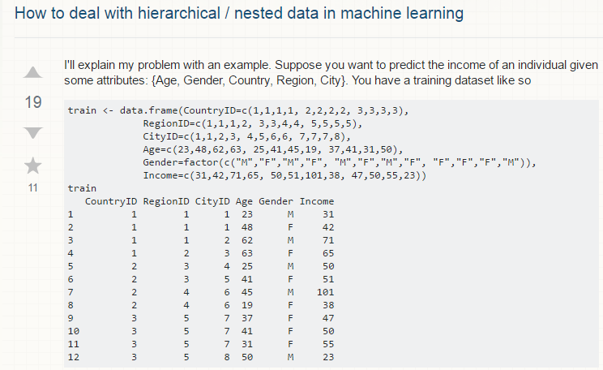
Background on Nested Data

Slide 37

Background on Nested Data

Slide 38
Background on Nested Data
Applied analysts working with complex nested data will benefit from knowing about mixed-effects models
Let us examine mixed-effects models in more detail, and show how these models can be estimated in R.

Slide 39
Background
Model Notation (Bryk & Raudenbush, 1992)
Separate components: One predictor at both levels, and random effects for intercept and slope
Y_{ij} = β_{0j}+ β_{1j}X_{ij} + r_{ij}
β_{0j} = γ₀₀ + γ₀₁Z_{j} + u_{0j}
β_{1j} = γ₁₀ + γ₁₁Z_{j} + u_{1j}
Combined
Y_{ij} =γ₀₀ + γ₁₀X_{ij} + γ₀₁Z_{j} + γ₁₁X_{ij}Z_{j} + [u_{0j} + u_{1j}X_{ij} + r_{ij}]

Slide 40
OLS Regression
xyplot(LEAD~HRS,
data=bh1996[bh1996$GRP==1,]
type=c("p","g","r"),
col="dark blue",
col.line="red3")
}
Variance of r_{ij} = σ²

Slide 41
OLS Regression
> tmod<-lm(LEAD~HRS,bh1996[bh1996$GRP==1,])
> resid(tmod)[1:5] #first 5 residuals
1 2 3 4 5
0.37033337 0.07394684 0.82487882 0.20844650 0.16112798
> summary(tmod)
....
Residual standard error: 0.6817 on 72 degrees of freedom
Multiple R-squared: 0.07543, Adjusted R-squared: 0.06258
F-statistic: 5.874 on 1 and 72 DF, p-value: 0.01788
> sd(resid(tmod)) #uses n-1
[1] 0.6769992
> summary(tmod)$sigma #uses n-p
[1] 0.6816844
}

Slide 42
OLS Regression
Fundamentally, regression is about minimizing residual error
> tmod<-lm(LEAD~1,bh1996[bh1996$GRP==1,])
> summary(tmod)$sigma
[1] 0.7040725
> tmod<-lm(LEAD~HRS,bh1996[bh1996$GRP==1,])
> summary(tmod)$sigma
[1] 0.6816844
> tmod<-lm(LEAD~HRS+rnorm(74),bh1996[bh1996$GRP==1,])
> summary(tmod)$sigma
[1] 0.6834704
> tmod<-lm(LEAD~HRS+COHES,bh1996[bh1996$GRP==1,])
> summary(tmod)$sigma
[1] 0.5661336
}

Slide 43
Background
Model Notation (Bryk & Raudenbush, 1992)
Separate components: One predictor at both levels, and random effects for intercept and slope
Y_{ij} = β_{0j}+ β_{1j}X_{ij} + r_{ij}
β_{0j} = γ₀₀ + γ₀₁Z_{j} + u_{0j}
β_{1j} = γ₁₀ + γ₁₁Z_{j} + u_{1j}
Combined
Y_{ij} =γ₀₀ + γ₁₀X_{ij} + γ₀₁Z_{j} + γ₁₁X_{ij}Z_{j} + [u_{0j} + u_{1j}X_{ij} + r_{ij}]

Slide 44
Random Intercept
> tmod<-lme(LEAD~HRS,random=~1|GRP,data=bh1996)
> plot(LEAD~HRS,TDAT,type="n")
> apply(coef(tmod),1,abline)
}
Variance of u_{0j} = τ₀₀

Slide 45
Random Intercept
> tmod<-lme(LEAD~HRS,random=~1|GRP,bh1996)
> VarCorr(tmod)
GRP = pdLogChol(1)
Variance StdDev
(Intercept) 0.08296611 0.2880384
Residual 0.51494780 0.7175986
> coef(tmod)[1:3,] #Empirical Bayes (EB)
(Intercept) HRS
1 3.344941 -0.03807717
2 2.982450 -0.03807717
3 3.329375 -0.03807717
> apply(coef(tmod),2,mean)
(Intercept) HRS
3.32075854 -0.03807717
> ranef(tmod)[1:3,1]
[1] 0.024182518 -0.338308234 0.008616911
> sd(ranef(tmod)[,1]) #approx. estimate based of EB
[1] 0.2737037
}

Slide 46
Random Intercept
> tmod<-lme(LEAD~HRS,random=~1|GRP,bh1996)
> VarCorr(tmod)
GRP = pdLogChol(1)
Variance StdDev
(Intercept) 0.08296611 0.2880384
Residual 0.51494780 0.7175986
> tmod<-lme(LEAD~HRS+G.HRS+G.COHES,random=~1|GRP,bh1996)
> VarCorr(tmod)
GRP = pdLogChol(1)
Variance StdDev
(Intercept) 0.03955954 0.1988958
Residual 0.51499888 0.7176342
> round(summary(tmod)$tTable,dig=4)
Value Std.Error DF t-value p-value
(Intercept) 1.6869 0.4483 7282 3.7625 0.0002
HRS -0.0367 0.0040 7282 -9.2368 0.0000
G.HRS -0.0869 0.0262 96 -3.3114 0.0013
G.COHES 0.8507 0.1009 96 8.4349 0.0000
}

Slide 47
Random Intercept
> tmod<-lme(LEAD~HRS,random=~1|GRP,data=bh1996) #Left
> tmod<-lme(LEAD~HRS+G.HRS+G.COHES,random=~1|GRP,bh1996) #Right
> plot(LEAD~HRS,TDAT,type="n",ylim=c(-1,4))
> apply(coef(tmod),1,abline) #Left
> apply(coef(tmod)[,1:2],1,abline) #Right

Slide 48
Background
Model Notation (Bryk & Raudenbush, 1992)
Separate components: One predictor at both levels, and random effects for intercept and slope
Y_{ij} = β_{0j}+ β_{1j}X_{ij} + r_{ij}
β_{0j} = γ₀₀ + γ₀₁Z_{j} + u_{0j}
β_{1j} = γ₁₀ + γ₁₁Z_{j} + u_{1j}
Combined
Y_{ij} =γ₀₀ + γ₁₀X_{ij} + γ₀₁Z_{j} + γ₁₁X_{ij}Z_{j} + [u_{0j} + u_{1j}X_{ij} + r_{ij}]

Slide 49
Random Slope
> tmod<-lme(LEAD~HRS,random=~HRS|GRP,data=bh1996)
> plot(LEAD~HRS,TDAT,type="n")
> apply(coef(tmod),1,abline)
Variance of u_{1j} = τ₁₁
Less obvious, but slopes
are not parallel

Slide 50
Random slope
> tmod<-lme(LEAD~HRS,random=~HRS|GRP,bh1996)
> VarCorr(tmod)
GRP = pdLogChol(HRS)
Variance StdDev Corr
(Intercept) 0.1258528893 0.35475751 (Intr)
HRS 0.0004076877 0.02019128 -0.589
Residual 0.5131379516 0.71633648
> coef(tmod)[1:3,] #Empirical Bayes (EB)
(Intercept) HRS
1 3.457299 -0.04837779
2 3.079954 -0.04619666
3 3.315930 -0.03680048
> apply(coef(tmod),2,mean)
(Intercept) HRS
3.31318657 -0.03754157
> ranef(tmod)[1:3,2]
[1] -0.0108362149 -0.0086550834 0.0007410909
> sd(ranef(tmod)[,2]) #Estimate based on EB
[1] 0.008935504

Slide 51
Random slope
> tmod<-lme(LEAD~HRS,random=~1|GRP,bh1996)
> VarCorr(tmod)
GRP = pdLogChol(1)
Variance StdDev
(Intercept) 0.08296611 0.2880384
Residual 0.51494780 0.7175986
> tmod2<-lme(LEAD~HRS,random=~HRS|GRP,bh1996)
> VarCorr(tmod2)
GRP = pdLogChol(HRS)
Variance StdDev Corr
(Intercept) 0.1258528893 0.35475751 (Intr)
HRS 0.0004076877 0.02019128 -0.589
Residual 0.5131379516 0.71633648
> anova(tmod,tmod2)
Model df AIC BIC logLik Test L.Ratio p-value
tmod 1 4 16312.44 16340.07 -8152.220
tmod2 2 6 16312.24 16353.68 -8150.122 1 vs 2 4.197098 0.1226

Slide 52
Random Slope
Cross-level interactions involve adding an interaction term between an upper-level and lower-level variable
An example of how to code. NS result
> tmod<-lme(LEAD~HRS+G.COHES+HRS*G.COHES,random=~HRS|GRP,bh1996)
> round(summary(tmod)$tTable,dig=4)
Value Std.Error DF t-value p-value
(Intercept) 0.5197 0.7943 7281 0.6542 0.5130
HRS -0.0297 0.0650 7281 -0.4566 0.6480
G.COHES 0.9146 0.2595 97 3.5241 0.0007
HRS:G.COHES -0.0027 0.0213 7281 -0.1292 0.8972

Slide 53
Random Slope
Multiple Random slopes possible
Choice guided by theory and model comparisons
#Examples only. The data.frame, mydata, does not exist
> tmod1<-lme(LEAD~HRS+WBEING+COHES+AGE+G.HRS+G.COHES+GSIZE,
random=~HRS|GRP,data=mydata)
> tmod2<-lme(LEAD~HRS+WBEING+COHES+AGE+G.HRS+G.COHES+GSIZE,
random=~HRS+AGE|GRP,data=mydata)
> tmod3<-lme(LEAD~HRS+WBEING+COHES+AGE+G.HRS+G.COHES+GSIZE,
random=~HRS+AGE+COHES|GRP,data=mydata)
> anova(tmod1,tmod2,tmod3) #Model contrasts

Slide 54
Random Slope Example
Platoon-Level Variation in the Relationship Between Combat Exposures and Acute Stress
Bliese, Adler, & Castro, (2011).
Notes:
54
Bliese, P. D., Adler, A. B., & Castro, C. A. (2011). Research-based preventive mental health care strategies in the military. In A. B. Adler, P. D. Bliese, & C. A. Castro (Eds.), Deployment Psychology: Evidence-Based Strategies to Promote Mental Health in the Military (pp. 103-124). Washington, DC: American Psychological Association.

Slide 55
Full Example
Data collected from US Army Soldiers in Nov-Dec of 1994.
Bliese & Britt (2001)
Bliese, Schriesheim, & Halverson (2002)
Peacekeeping mission and survey data
2,042 surveys from 49 company-sized Army units
Research question
Do shared perceptions of leaders among unit members buffer the relationship between task significance and anger/hostility?
Stated otherwise, if a soldier is performing tasks they dislike, will it help if they collectively feel that their unit leadership is good

Slide 56
Random Slope
Code to perform analyses
> library(multilevel)
> data(lq2002)
> null.mod<-lme(HOSTILE~1,random=~1|COMPID, data=lq2002,
control=list(opt="optim"))
> VarCorr(null.mod) #Mixed Effect method to estimate ICC
COMPID = pdLogChol(1)
Variance StdDev
(Intercept) 0.05949609 0.2439182
Residual 1.01669303 1.0083120
> 0.05949609/(0.05949609+1.01669303)
[1] 0.05528405

Slide 57
Random Slope
> xyplot(HOSTILE~TSIG|as.factor(COMPID),
data=lq2002[lq2002$COMPID<30,],
type=c("g","r","p"),col="dark blue",
col.line="red3") #first 25 groups

Slide 58
Random Slope
Code to perform analyses: Is slope variance significant?
> tmod1<-lme(HOSTILE~TSIG,random=~1|COMPID, data=lq2002,
control=list(opt="optim"))
> tmod2<-update(tmod1,random=~TSIG|COMPID)
> VarCorr(tmod2)
COMPID = pdLogChol(TSIG)
Variance StdDev Corr
(Intercept) 0.33093318 0.5752679 (Intr)
TSIG 0.01675666 0.1294475 -0.99
Residual 0.90158029 0.9495158
> anova(tmod1,tmod2)
Model df AIC BIC logLik Test L.Ratio p-value
tmod1 1 4 5679.149 5701.632 -2835.575
tmod2 2 6 5658.818 5692.542 -2823.409 1 vs 2 24.33168 <.0001

Slide 59
Random Slope
Code to perform analyses: Is shared leadership a moderator of the slope between individual task significance and hostility?
> tmod3<-lme(HOSTILE~TSIG*GLEAD,random=~TSIG|COMPID,
data=lq2002, control=list(opt="optim"))
> round(summary(tmod3)$tTable,dig=4)
Value Std.Error DF t-value p-value
(Intercept) 6.0328 1.0508 1991 5.7414 0.0000
TSIG -1.1539 0.2913 1991 -3.9617 0.0001
GLEAD -1.3844 0.3488 47 -3.9694 0.0002
TSIG:GLEAD 0.2824 0.0964 1991 2.9285 0.0034

Slide 60
Random Slope
One way to look at the interaction
> summary(lq2002$GLEAD)
Min. 1st Qu. Median Mean 3rd Qu. Max.
2.379 2.811 2.984 3.001 3.176 3.739
> xyplot(HOSTILE~TSIG|as.factor(COMPID),
data=lq2002[lq2002$GLEAD<3,],
type=c("g","r","p"),col="dark blue",
col.line="red3")
> xyplot(HOSTILE~TSIG|as.factor(COMPID),
data=lq2002[lq2002$GLEAD>3,],
type=c("g","r","p"),col="dark blue",
col.line="red3")

Slide 61
Random Slope
Low leadership ratings (left) High leadership ratings (right)

Slide 62
Random Slope
Model the interaction with parameter estimates
> summary(lq2002$GLEAD[!duplicated(lq2002$COMPID)])
Min. 1st Qu. Median Mean 3rd Qu. Max.
2.379 2.843 3.062 3.057 3.250 3.739
> sd(lq2002$GLEAD[!duplicated(lq2002$COMPID)])
[1] 0.3202388
> summary(lq2002$TSIG)
Min. 1st Qu. Median Mean 3rd Qu. Max.
1.000 2.333 3.333 3.133 4.000 5.000
> sd(lq2002$TSIG)
[1] 1.02007
> TDAT<-data.frame(TSIG=c(2.11,2.11,4.15,4.15),
+ GLEAD=c(2.74,3.38,2.74,3.38))
> TDAT$HOSTILE<-predict(tmod3,TDAT,level=0)
> with(TDAT,interaction.plot(TSIG,GLEAD,HOSTILE))

Slide 63
Random Slope
A way to model the interaction

Slide 64
Longitudinal (Panel) Data

Slide 65
Background on Longitudinal Data
The issues about non-independence raised about nested data are also present in longitudinal data
Longitudinal data (or panel data) tends to be more extreme with respect to non-independence
Data Structure and Examples (to follow examples)
> library(multilevel)
> data(univbct) #move data from library to workspace

Slide 66
Background on Longitudinal Data
Data Structure
> univbct[1:12,c("SUBNUM","TIME","JSAT")]
SUBNUM TIME JSAT
1 1 0 1.666667
2 1 1 1.000000
3 1 2 3.000000
4 2 0 3.666667
5 2 1 4.000000
6 2 2 4.000000
7 3 0 4.000000
8 3 1 4.000000
9 3 2 4.000000
10 4 0 3.333333
11 4 1 3.666667
12 4 2 3.000000

Slide 67
Background on Longitudinal Data
ICC(1) value (non-independence – also just referred to as ICC)
A single vector or multiple vectors representing TIME is also common
> tmod<-aov(JSAT~as.factor(SUBNUM),data=univbct,
na.action=na.omit)
> ICC1(tmod)
[1] 0.500425

Slide 68
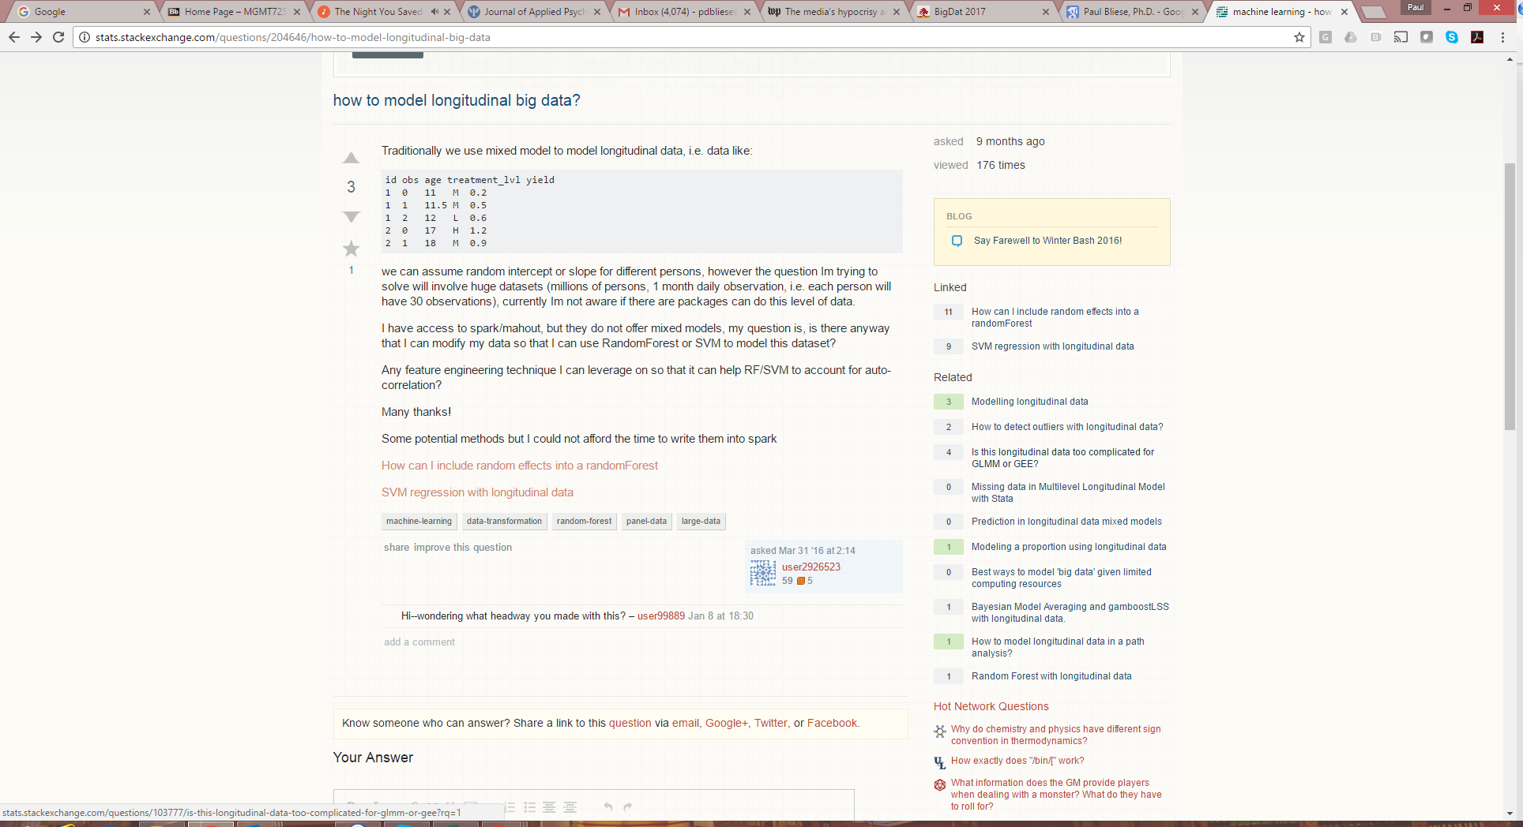
Background on Longitudinal Data

Slide 69
Background on Longitudinal Data
Point being that analysts may want to become familiar with approaches that can be applied to longitudinal data

Slide 70
Background on Longitudinal Data
Show how R can be used to conduct growth models.
Non Linear Mixed Effects (NLME) package (Pinheiro & Bates, 2000)
Multilevel package (Bliese, 2016)
Introduce a model contrasting approach to estimating growth models (Bliese & Ployhart, 2002).

Slide 71
Background on Longitudinal Data
Growth Modeling Defined
Modeling Steps
Build Level-1 Model
Estimate ICC
Identify Functions for Time
Examine Growth Parameter Variability
Determine Error Structure
Build Level-2 Model
Discontinuous Growth Models

Slide 72
Background on Longitudinal Data
Multilevel models consider nesting in terms of
Individuals nested (level-1)
Within Groups (level-2)
Basic two-level model can be expanded to cases where
Repeated observations nested (level-1)
Within Individuals (level-2)

Slide 73
Background on Longitudinal Data
Growth modeling involves looking at
Change patterns over time for the sample as a whole
Overall, does the DV increase, decrease etc.?
Individual differences in overall levels of the DV
Do mean levels of DV vary among individuals?
Individual differences in change patterns over time
Do growth patterns associated with the DV vary among individuals?
Allows one to predict individual differences in growth patterns

Slide 74
Background on Longitudinal Data
> xyplot(JSAT~TIME|as.factor(SUBNUM),
data=univbct[1:90,],
type=c("p","r","g"),
col="blue",col.line="black",
xlab="Time",
ylab="Job Satisfaction")

Slide 75
Modeling Steps
Notes on optimization in lme function
Build Level-1 Model (Bliese & Ployhart, 2002)
Step 1: Estimate the ICC
Step 2: Identify the Fixed Functions for Time
Linear,
Quadratic, etc.
Step 3: Examine Variability in Growth Parameters
Step 4: Determine the Error Structure
Are Errors (residuals) Correlated?
Are Errors Heterogeneous?
Build Level-2 Model (steps 5 and 6)
Add individual difference predictors (Level-2)

Slide 76
Optimization
The lme function uses two different routines in the stats package for optimization
The function optim
The function nlmimb
The default after versions 2.2 of R has been nlmimb
If complex models (either growth or multilevel) fail to converge, try using the optim function
> Final.Model<-lme(WBEING~LEAD+G.HRS+LEAD*G.HRS,
random=~LEAD|GRP,data=tbh1996,
control=list(opt="optim"))

Slide 77
Step 2 in Modeling
Identify Fixed Functions for Time
For the overall sample, does time have a linear, quadratic, etc relationship with the outcome?
Using orthogonal polynomials here
> tmod2<-lme(JSAT~poly(TIME,2),
random=~1|SUBNUM,data=univbct,
na.action=na.omit, control=list(opt="optim"))
> round(summary(tmod2)$tTable,dig=3)
Value Std.Error DF t-value p-value
(Intercept) 3.270 0.035 902 94.479 0.000
poly(TIME, 2)1 1.578 0.661 902 2.386 0.017
poly(TIME, 2)2 0.753 0.661 902 1.139 0.255

Slide 78
Step 3 in Modeling
Examine Variability in Growth Parameters
The high ICC tells us that intercepts vary
The test for fixed effects associated with TIME reveal an overall positive trend between TIME and job satisfaction
Does the linear slope for TIME randomly vary?
Does job satisfaction increase for some and decrease for others?

Slide 79
Step 3 in Modeling
Specifying a random linear slope in lme
> tmod2<-lme(JSAT~TIME,random=~1|SUBNUM,
data=univbct,na.action=na.omit, control=list(opt="optim"))
> tmod3<-update(tmod2,random=~TIME|SUBNUM)
> anova(tmod2,tmod3)
Model df logLik Test L.Ratio p-value
tmod 1 4 -1726.617
tmod3 2 6 -1711.066 1 vs 2 31.10262 <.0001

Slide 80
Step 3 in Modeling
The model with the random slope fits the data better than the model with the fixed slope
Notes:
tmod<-lme(JSAT~TIME,random=~TIME|SUBNUM,data=univbct,na.action=na.omit)
plot(univbct$TIME,univbct$JSAT,xlab="Time",
ylab="Job Satisfaction",type="n")
COEF.DAT<-coef(tmod)
apply(COEF.DAT,1,abline)

Slide 81
Step 4 in Modeling
In a well-specified model, there will not be any discernible pattern to the residuals.
The residuals should be unrelated to each other
When there is a pattern associated with the residuals, then this pattern needs to be accounted for in the model.
Failure to correctly model the error structure will lead to biases such as incorrect standard errors.

Slide 82
Step 4 in Modeling
Error structure specification is generally not an issue in multilevel models because lower-level observations are unordered.
In longitudinal data repeated measures are ordered and likely to create patterns of:
Autocorrelation
Observations close to each other in time are more related than observations far apart in time
Heteroscedasticity
Variance increases or decreases over time

Slide 83
Step 4 in Modeling
Check for autocorrelation in lme (AR1)
Final Step 3 Model
Add Autocorrelation
Contrast Models
> tmod3<-lme(JSAT~TIME,random=~TIME|SUBNUM,
data=univbct,na.action=na.omit, control=list(opt="optim"))
> tmod4a<-update(tmod3,
correlation=corAR1(form=~1|SUBNUM))
> anova(tmod3,tmod4a)
Model df logLik Test L.Ratio p-value
tmod3 1 6 -1711.066
tmod4a 2 7 -1707.861 1 vs 2 6.409824 0.0113

Slide 84
Step 4 in Modeling
Get estimate of the degree of autocorrelation
Phi coefficient is positive (Pinheiro & Bates, 2000, p. 229)
> summary(tmod4a)
Linear mixed-effects model fit by REML
Data: GROWSAT.UNIV
AIC BIC logLik
3429.722 3466.401 -1707.861
....
Correlation Structure: AR(1)
Formula: ~1 | SUBNUM
Parameter estimate(s):
Phi
0.3763924

Slide 85
Step 4 in Modeling
Formal check for heteroscedasticity
> tmod4b<-update(tmod4a,weights=varExp(form=~TIME))
# Warning Message
> anova(tmod4a,tmod4b)
Model df logLik Test L.Ratio p-value
tmod4a 1 7 -1707.861
tmod4b 2 8 -1706.199 1 vs 2 3.323143 0.0683

Slide 86
Step 4 in Modeling
Estimates of autocorrelation and heteroscedasticity
> summary(tmod4b)
....
Correlation Structure: AR(1)
Formula: ~1 | SUBNUM
Parameter estimate(s):
Phi
0.4019757
Variance function:
Structure: Exponential of variance covariate
Formula: ~TIME
Parameter estimates:
expon
-0.08626299

Slide 87
Final Level-1 Model
Final Level-1 model is:
> finlev1<-lme(JSAT~TIME,random=~TIME|SUBNUM,
data=univbct,
correlation=corAR1(form=~1|SUBNUM),
na.action=na.omit, control=list(opt="optim"))
> round(summary(finlev1)$tTable,dig=3)
Value Std.Error DF t-value p-value
(Intercept) 3.219 0.044 903 72.398 0.000
TIME 0.053 0.024 903 2.213 0.027
Average level of
Satisfaction at
Time 0 (first data
collection time)
Amount Satisfaction
increases with each
increment of TIME

Slide 88
Level-2 Model
In Level-2 (Individual) we can now predict
Intercept Differences (why mean satisfaction differs)
Slope Differences (why growth patterns differ)
Intercept Differences
> lev2mod1<-lme(JSAT~TIME+AGE,
random=~TIME|SUBNUM,data=univbct,
correlation=corAR1(form=~1|SUBNUM),
na.action=na.omit, control=list(opt="optim"))
> round(summary(lev2mod1)$tTable,dig=3)
Value Std.Error DF t-value p-value
(Intercept) 2.347 0.146 897 16.086 0.000
TIME 0.053 0.024 897 2.205 0.028
AGE 0.034 0.005 486 6.241 0.000

Slide 89
Level-2 Model
Slope Differences
> lev2mod2<-update(lev2mod1,MULTDV~TIME*AGE)
> round(summary(lev2mod2)$tTable,dig=3)
Value Std.Error DF t-value p-value
(Intercept) 2.098 0.186 896 11.264 0.000
TIME 0.271 0.104 896 2.608 0.009
AGE 0.043 0.007 486 6.180 0.000
TIME:AGE -0.008 0.004 896 -2.153 0.032

Slide 90
Level-2 Model
Plotting the Interaction by predicting four values
> TDAT<-data.frame(TIME=c(0,0,2,2),AGE=c(21,31,21,31))
> TDAT
TIME AGE
1 0 21
2 0 31
3 2 21
4 2 31
> predict(lev2mod2,TDAT,level=0)
[1] 3.010151 3.444641 3.198073 3.463921
attr(,"label")
[1] "Predicted values"

Slide 91
Level-2 Model
Plotting in R for quick visualization
> TDAT<-data.frame(TIME=c(0,0,2,2),AGE=c(21,31,21,31))
> TDAT$JSAT<-predict(lev2mod2,TDAT,level=0)
> with(TDAT,interaction.plot(TIME,AGE,JSAT,ylim=c(2,4)))

Slide 92
Step Summary (part 1)

Slide 93
Step Summary (part 2)

Slide 94
Discontinuous Growth Models
Discontinuous growth models
Bliese & Lang, 2016
Bliese, Adler & Flynn, (forthcoming)

Slide 95
Discontinuous Growth Models
Allows one to build upon traditional growth models to incorporate events associated with abrupt changes
Unanticipated events such as financial shocks (State-level GDP and the Great Recession)
Anticipated events in field data collections (measuring sleep in different settings)
Anticipated events in laboratory experiments (adaptability and the task-change paradigm)

Slide 96

Discontinuous Growth Models

Slide 97
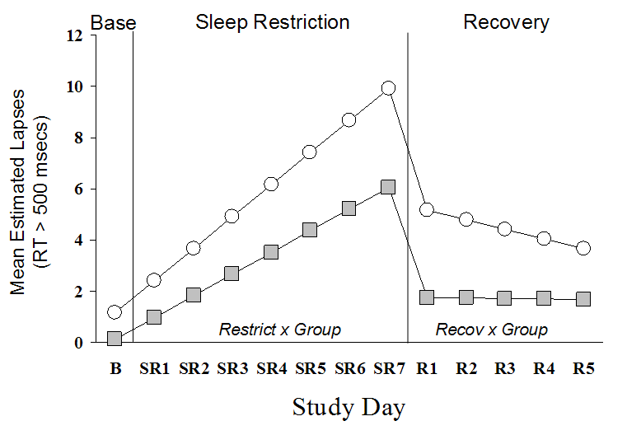
Discontinuous Growth Models
Sleep banking (Rupp, Wesensten, Bliese & Balkin, 2009)

Slide 98

Discontinuous Growth Models

Slide 99
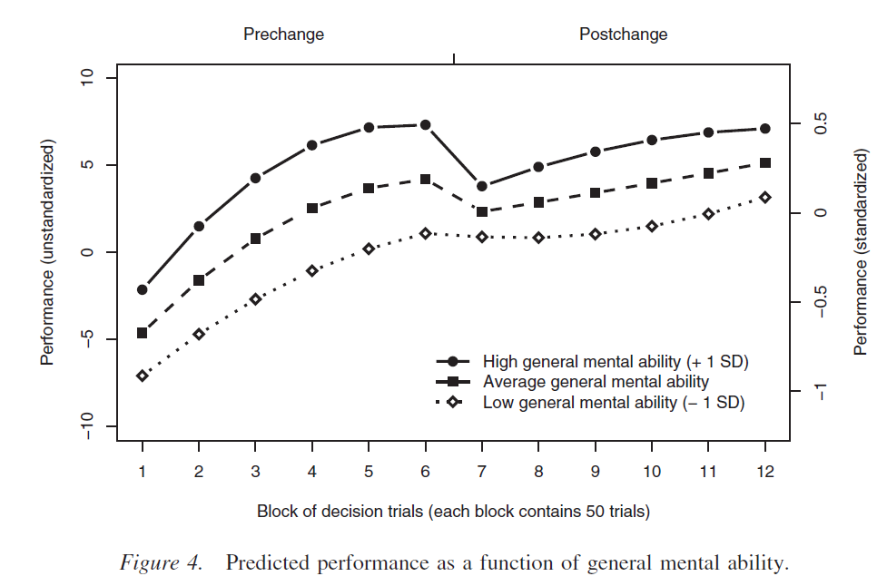
Discontinuous Growth Models

Slide 100

Discontinuous Growth Models

Slide 101
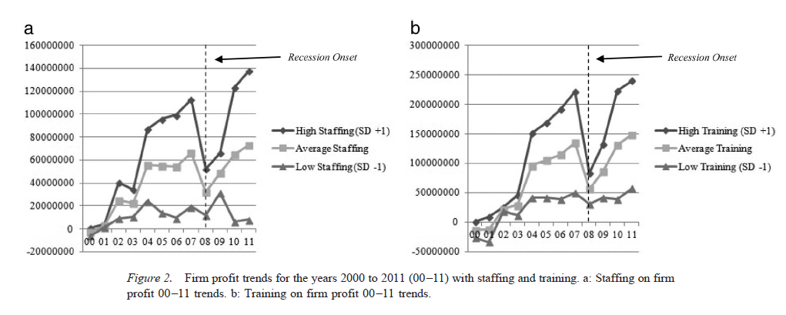
Discontinuous Growth Models

Slide 102

Discontinuous Growth Models

Slide 103
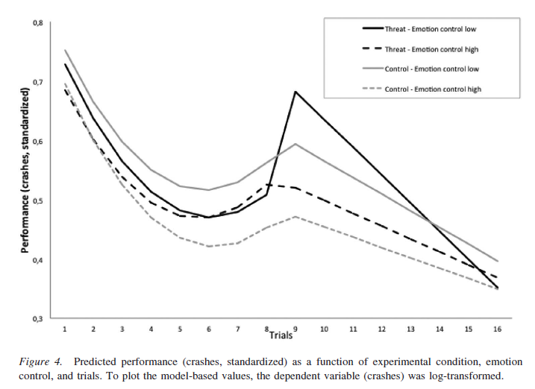
Discontinuous Growth Models

Slide 104

Discontinuous Growth Models

Slide 105

Discontinuous Growth Models

Slide 106
Longitudinal Designs

Slide 107
Longitudinal Designs

Slide 108
Longitudinal Designs
The fundamentals of discontinuous growth model specifications are simple but the interpretation of parameters can become quite complex when designs involve:
Multiple discontinuities
Interactive patterns

Slide 109
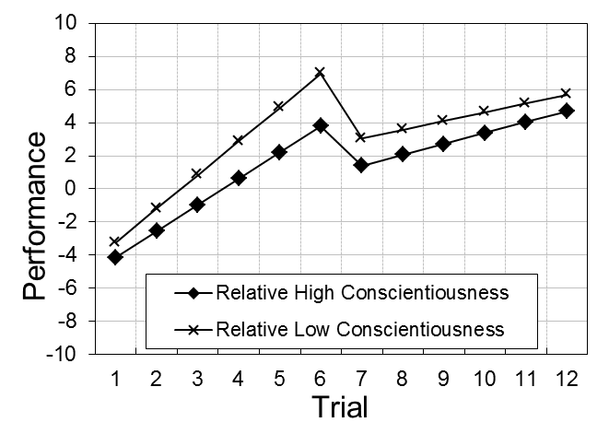

Longitudinal Designs
The absolute versus relative differentiation has particularly important implications when dealing with entity-level predictors and interactions
2 way hypothesis
3 way hypothesis

Slide 110
Longitudinal Designs

Slide 111
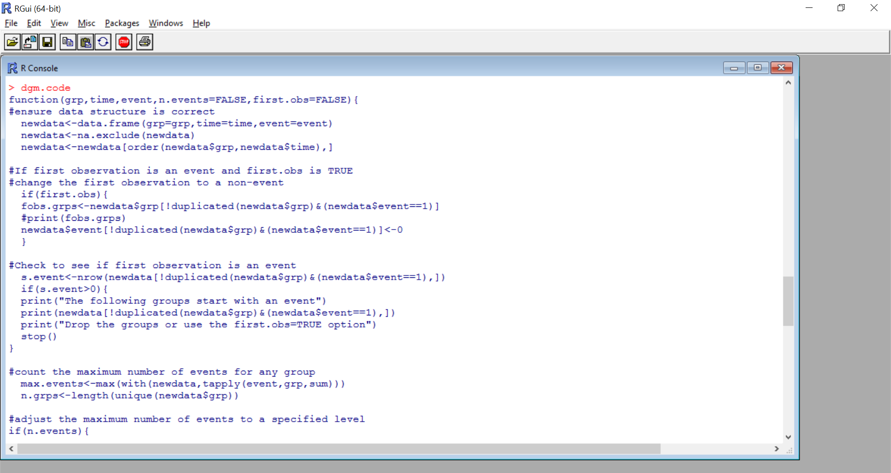
Longitudinal Designs
Automating the process (dgm.code)

Slide 112
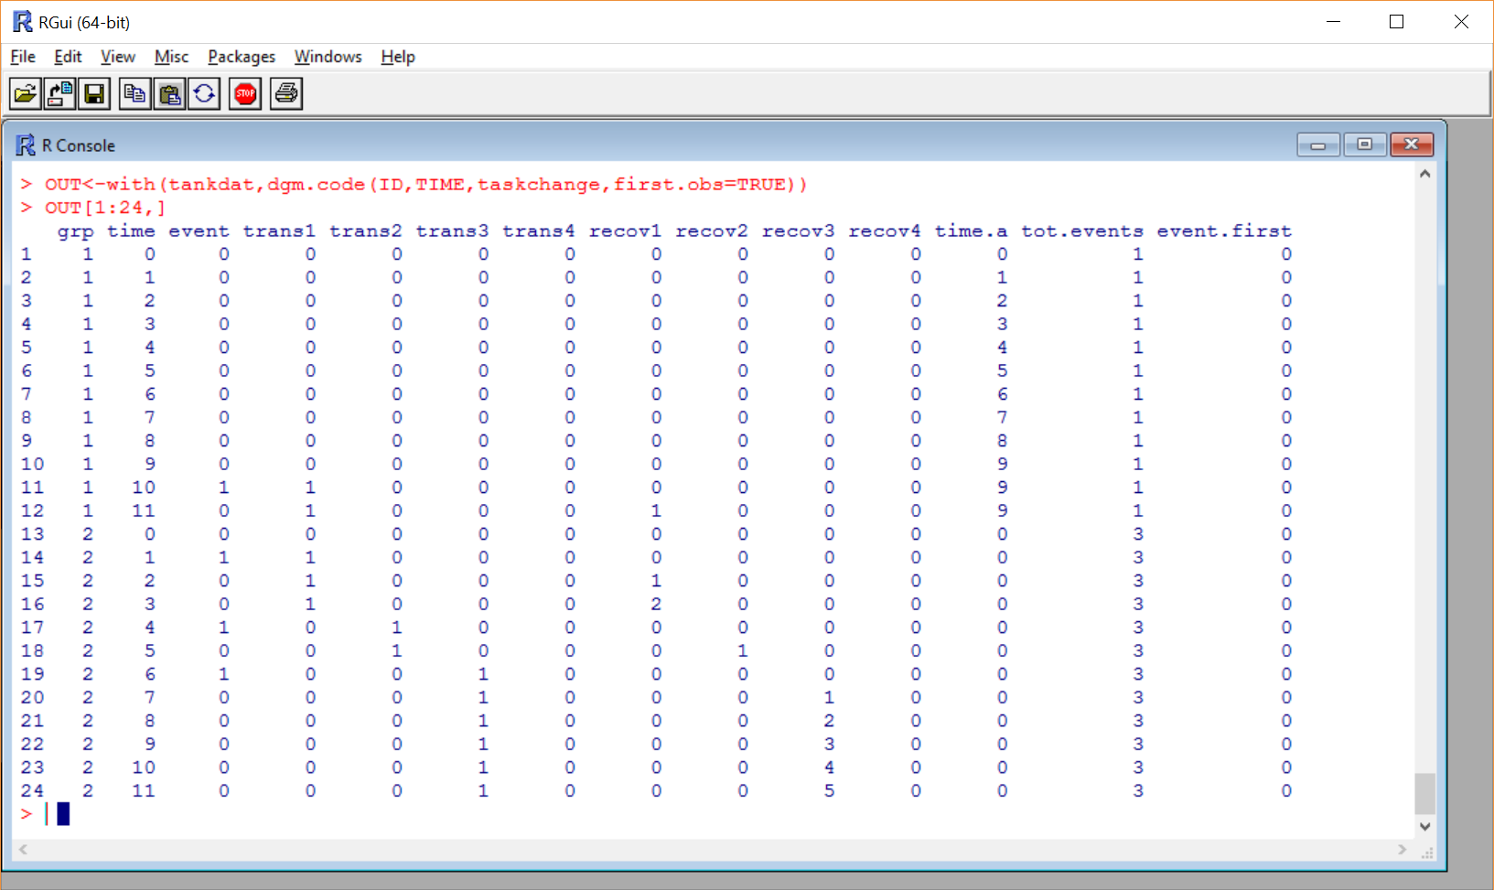
Longitudinal Designs
Automating the process (dgm.code)

Slide 113
State-Level GDP Change
Notes:
library(lattice)
xyplot(gdp1k~I(TIME+1997)|as.factor(Area),
data=gdp.univ[1:240,],
layout = c(4,4),
type=c("p","g"),cex=1.2,pch=20,
col="black",
xlab=list("YEAR",cex=1.5),
ylab=list("GDP / 100K",cex=1.5))

Slide 114
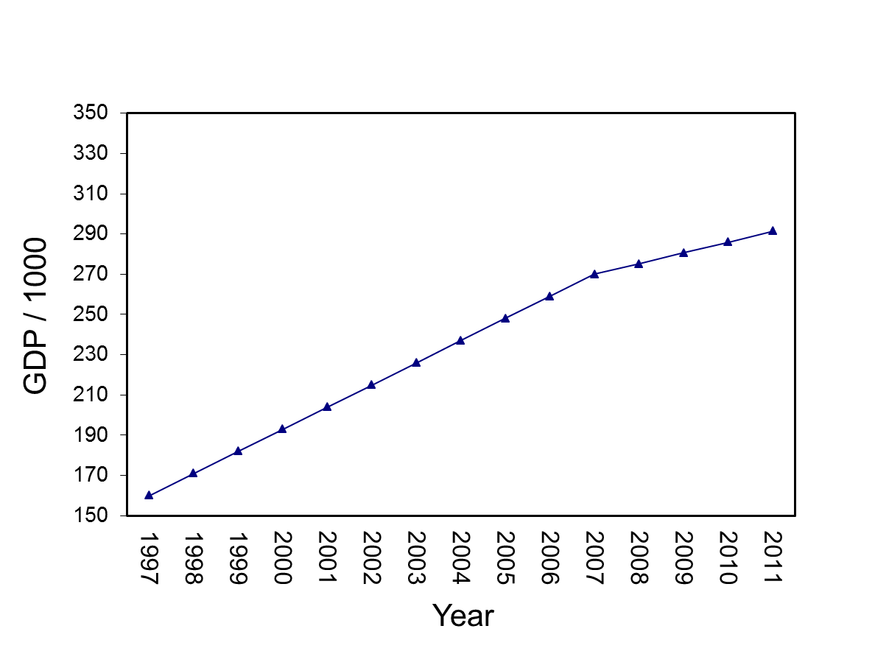
State-Level GDP Change
Notes:
TDAT<-gdp.univ[1:15,c("TIME","Trans","Recov")]
quantile(pinc[,2],c(.33,.66))/1000
median(pinc[,2])/1000
TDAT$Pinc20081k=149324.7
write.table(t(predict(mod4,TDAT,level=0)),file="clipboard", sep="\t",col.names=F,row.names=F)

Slide 115
State-Level GDP Change
Notes:
TDAT<-gdp.univ[1:15,c("TIME","Trans","Recov")]
quantile(pinc[,2],c(.33,.66))/1000
median(pinc[,2])/1000
TDAT$Pinc20081k=149324.7
write.table(t(predict(mod4,TDAT,level=0)),file="clipboard", sep="\t",col.names=F,row.names=F)

Slide 116
State-Level GDP Change
1. What is the overall pattern (pre-transition slope, transition change, post-transition slope) over time?
2. Are there differences in overall levels of GDP (intercept)?
3. Do States differ on pre-transition slopes, transition change, post-transition slopes?
4. What State-level variables predict pre-transition slope, transition change, post-transition slope?
Notes:
TDAT<-gdp.univ[1:15,c("TIME","Trans","Recov")]
quantile(pinc[,2],c(.33,.66))/1000
median(pinc[,2])/1000
TDAT$Pinc20081k=149324.7
write.table(t(predict(mod4,TDAT,level=0)),file="clipboard", sep="\t",col.names=F,row.names=F)

Slide 117
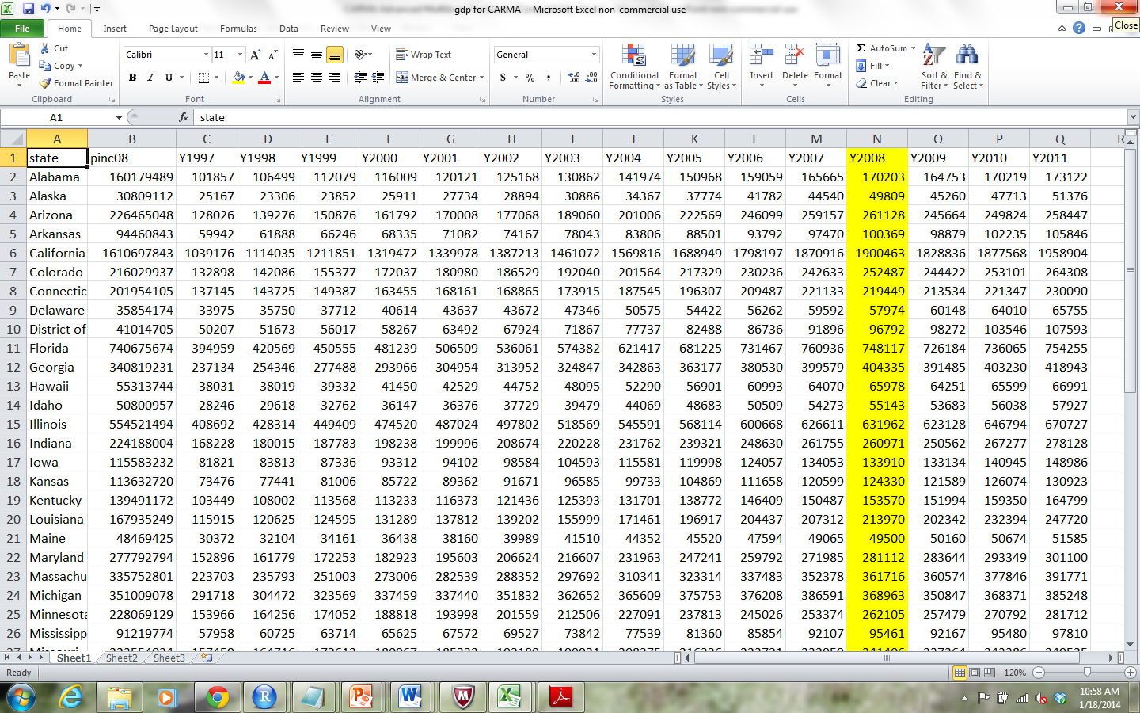
GDP Example
State-level GDP for 15 years (1997-2011)
In 1998, “Great Recession”

Slide 118
Growth Modeling Setup
Read data into R:
Copy data in EXCEL (Ctrl-C) “Discontinuous Growth State GDP 1997 to 2011.xlsx”
Paste into R with commands below
> gdpdata<-read.table(file="clipboard",sep="\t",header=T)
> names(gdpdata)
[1] "state" "pinc08" "Y1997" "Y1998" "Y1999" "Y2000"
[7] "Y2001" "Y2002" "Y2003" "Y2004" "Y2005" "Y2006"
[13] "Y2007" "Y2008" "Y2009" "Y2010" "Y2011"
> #For MAC users
> gdpdata<-read.table(pipe("pbpaste"),sep="\t",header=T)

Slide 119
Convert Data to Univariate Form
> names(gdpdata)
[1] "state" "pinc08" "Y1997" "Y1998" "Y1999" "Y2000"
[7] "Y2001" "Y2002" "Y2003" "Y2004" "Y2005" "Y2006"
[13] "Y2007" "Y2008" "Y2009" "Y2010" "Y2011"
> library(multilevel)
> gdpdata.univ<-make.univ(gdpdata,gdpdata[,3:17],
outname="gdp")

Slide 120
gdp 1997-2011: Alabama
> gdpdata.univ[1:15,c(1:5,18:19)]
state pinc08 Y1997 Y1998 Y1999 TIME gdp
1 Alabama 160179489 101857 106499 112079 0 101857
1.1 Alabama 160179489 101857 106499 112079 1 106499
1.2 Alabama 160179489 101857 106499 112079 2 112079
1.3 Alabama 160179489 101857 106499 112079 3 116009
1.4 Alabama 160179489 101857 106499 112079 4 120121
1.5 Alabama 160179489 101857 106499 112079 5 125168
1.6 Alabama 160179489 101857 106499 112079 6 130862
1.7 Alabama 160179489 101857 106499 112079 7 141974
1.8 Alabama 160179489 101857 106499 112079 8 150968
1.9 Alabama 160179489 101857 106499 112079 9 159059
1.10 Alabama 160179489 101857 106499 112079 10 165665
1.11 Alabama 160179489 101857 106499 112079 11 170203
1.12 Alabama 160179489 101857 106499 112079 12 164753
1.13 Alabama 160179489 101857 106499 112079 13 170219
1.14 Alabama 160179489 101857 106499 112079 14 173122

Slide 121
Make GDP more Manageable by Dividing by 1000
> gdpdata.univ[1:16,
c("state","TIME","gdp")]
state TIME gdp
1 Alabama 0 101857
1.1 Alabama 1 106499
1.2 Alabama 2 112079
1.3 Alabama 3 116009
1.4 Alabama 4 120121
1.5 Alabama 5 125168
1.6 Alabama 6 130862
1.7 Alabama 7 141974
1.8 Alabama 8 150968
1.9 Alabama 9 159059
1.10 Alabama 10 165665
1.11 Alabama 11 170203
1.12 Alabama 12 164753
1.13 Alabama 13 170219
1.14 Alabama 14 173122
2 Alaska 0 25167
> gdpdata.univ$gdp1k<-
gdpdata.univ$gdp/1000
> gdpdata.univ[1:10,
c("state","TIME","gdp","gdp1k")]
state TIME gdp gdp1k
1 Alabama 0 101857 101.857
1.1 Alabama 1 106499 106.499
1.2 Alabama 2 112079 112.079
1.3 Alabama 3 116009 116.009
1.4 Alabama 4 120121 120.121
1.5 Alabama 5 125168 125.168
1.6 Alabama 6 130862 130.862
1.7 Alabama 7 141974 141.974
1.8 Alabama 8 150968 150.968
1.9 Alabama 9 159059 159.059

Slide 122
Create Time-Related Covariates
Discontinuity is captured by adding additional TIME-based covariates
Break time into segments
The discontinuous growth model we consider uses three TIME-based covariates to capture
Pre-discontinuity slope (TIME)
Change at the transition (TRANS)
Post-discontinuity transition slope (RECOV)

Slide 123
Create Time-Related Covariates
TRANS
RECOV
TIME
Notes:
TDAT<-gdp.univ[1:15,c("TIME","Trans","Recov")]
quantile(pinc[,2],c(.33,.66))/1000
median(pinc[,2])/1000
TDAT$Pinc20081k=149324.7
write.table(t(predict(mod4,TDAT,level=0)),file="clipboard", sep="\t",col.names=F,row.names=F)

Slide 124
Create Time-Related Covariates
The TIME-based covariate for the Transition (TRANS) is a dummy-coded variable
Pre-transition coded as 0
Post-transition coded as 1
In our example, 2008 is the year of discontinuity
TIME 0 to 10 (1997 to 2007) is pre-recession
TIME 11 to 14 (2008 to 2011) is post-recession
The ifelse function in R can be used to efficiently create the TRANS variable
gdpdata.univ$TRANS<-ifelse(gdpdata.univ$TIME>10,1,0)

Slide 125
Create Time-Related Covariates
The TIME-based covariate for the recovery slope (RECOV) is a combination of dummy and continuous
Pre-transition coded as 0
Post-transition slope coded 0 to n-1 post transition observations
In our example
TIME 0 to 10 (1997 to 2007) coded as 0
TIME 11 to 14 (2008 to 2011) coded 0,1,2,3
R code subtracts 11 from TIME (step1) and then changes negative numbers to 0 (step 2)
> gdpdata.univ$RECOV<-gdpdata.univ$TIME-11
> gdpdata.univ$RECOV[gdpdata.univ$RECOV<0]<-0

Slide 126
Create Time-Related Covariates
> gdpdata.univ[1:15,c("state","TIME","TRANS","RECOV")]
state TIME TRANS RECOV
1 Alabama 0 0 0
1.1 Alabama 1 0 0
1.2 Alabama 2 0 0
1.3 Alabama 3 0 0
1.4 Alabama 4 0 0
1.5 Alabama 5 0 0
1.6 Alabama 6 0 0
1.7 Alabama 7 0 0
1.8 Alabama 8 0 0
1.9 Alabama 9 0 0
1.10 Alabama 10 0 0
1.11 Alabama 11 1 0
1.12 Alabama 12 1 1
1.13 Alabama 13 1 2
1.14 Alabama 14 1 3

Slide 127
Step 1: ICC estimate
ICC values are important to estimate
In this example, the ICC value is extremely high (0.94) working against finding discontinuous effects
Large differences across States
Low within-State variability
> null.mod<-lme(gdp1k~1,random=~1|state,gdpdata.univ, control=list(opt="optim"))
> VarCorr(null.mod)
state = pdLogChol(1)
Variance StdDev
(Intercept) 76969.042 277.43295
Residual 5140.942 71.70036
> 76969.042/(76969.042+5140.942)
[1] 0.9373896

Slide 128
Step 2 in Modeling
In one block examine fixed effects associated with
TIME
TRANS
RECOV
Only TIME is significant (but we will continue to examine data)
> mod2<-lme(gdp1k~TIME+TRANS+RECOV,random=~1|state,
gdpdata.univ,control=list(opt="optim"))
> round(summary(mod2)$tTable,dig=4)
Value Std.Error DF t-value p-value
(Intercept) 158.7940 39.1391 711 4.0572 0.0001
TIME 10.8671 0.7594 711 14.3098 0.0000
TRANS -5.4987 8.4224 711 -0.6529 0.5141
RECOV -5.0914 3.6421 711 -1.3980 0.1626

Slide 129
Interpreting Step 2
In 1997 (TIME 0), the average level of GDP across the 51 States was 158794 (158.794*1000)
GDP increased by 10867.129 each year
GDP dropped by 5498.661 in 2008 (relative to expected increase)
Recovery slope of -5091.427 indicates the recovery slope is weaker than the slope associated with the period before 2008 (but still positive)
> mod2<-lme(gdp1k~TIME+TRANS+RECOV,random=~1|state,
gdpdata.univ,control=list(opt="optim"))
> round(summary(mod2)$tTable,dig=4)
Value Std.Error DF t-value p-value
(Intercept) 158.7940 39.1391 711 4.0572 0.0001
TIME 10.8671 0.7594 711 14.3098 0.0000
TRANS -5.4987 8.4224 711 -0.6529 0.5141
RECOV -5.0914 3.6421 711 -1.3980 0.1626

Slide 130
Create Time-Related Covariates
Recovery slope 5091.427
Less than original slope
TRANS
RECOV
Drop of 5498.661
TIME
10867.129 yearly increase
GDP at Time 0
equals 158794
Notes:
TDAT<-gdp.univ[1:15,c("TIME","Trans","Recov")]
quantile(pinc[,2],c(.33,.66))/1000
median(pinc[,2])/1000
TDAT$Pinc20081k=149324.7
write.table(t(predict(mod4,TDAT,level=0)),file="clipboard", sep="\t",col.names=F,row.names=F)

Slide 131
Step 3: Modeling State Variability
Examine potential variability in time-based parameters
Add random slopes one at a time and contrast models
Best fit for model with random slopes for TIME, TRANS and RECOV
Suggests significant variability in all Time related parameters across States
> mod3.a<-update(mod2,random=~TIME|state)
> mod3.b<-update(mod3.a,random=~TIME+TRANS|state)
> mod3.c<-update(mod3.b,random=~TIME+TRANS+RECOV|state)
> anova(mod2,mod3.a,mod3.b,mod3.c)
Model df AIC BIC logLik Test L.Ratio p-value
mod2 1 6 8641.864 8669.671 -4314.932
mod3.a 2 8 6683.111 6720.189 -3333.556 1 vs 2 1962.7521 <.0001
mod3.b 3 11 6540.190 6591.171 -3259.095 2 vs 3 148.9212 <.0001
mod3.c 4 15 6379.728 6449.247 -3174.864 3 vs 4 168.4627 <.0001

Slide 132
Step 3: Modeling State Variability
Contrast models with fixed slopes vs random slopes
Both models convey that parameters are variable
one through large SE’s
one showing significant variability among States
> round(summary(mod2)$tTable,dig=4)
Value Std.Error DF t-value p-value
(Intercept) 158.7940 39.1391 711 4.0572 0.0001
TIME 10.8671 0.7594 711 14.3098 0.0000
TRANS -5.4987 8.4224 711 -0.6529 0.5141
RECOV -5.0914 3.6421 711 -1.3980 0.1626
> round(summary(mod3.c)$tTable,dig=4)
Value Std.Error DF t-value p-value
(Intercept) 158.7940 26.1591 711 6.0703 0.0000
TIME 10.8671 1.9922 711 5.4550 0.0000
TRANS -5.4987 2.2932 711 -2.3978 0.0168
RECOV -5.0914 1.4221 711 -3.5803 0.0004

Slide 133
Step 4: Testing for Autocorrelation
Up to now, models assume independent errors in the covariance structure of the data.
No pattern to level-1 model residuals
Assumption of independent errors is rarely supported when dealing with repeated measures over time.
As Littell, Milliken, Stroup, and Wolfinger (1996) note, “measurements taken at adjacent times are typically more highly correlated than two measurements taken several time points apart” (p. 88).

Slide 134
Step 4: Testing for Autocorrelation
The correlation option in lme specifies alternative within-group correlation structures.
A common structure is corAR1() or first-order autoregressive
Update mod3.c and contrasting the -2 log likelihood values between the two models
Notice 1 df difference for the estimate of phi in mod4
> mod4<-update(mod3.c,correlation=corAR1(form=~TIME|state))
> anova(mod3.c,mod4)
Model df AIC BIC logLik Test L.Ratio p-value
mod3.c 1 15 6379.728 6449.247 -3174.864
mod4 2 16 6095.525 6169.679 -3031.762 1 vs 2 286.2027 <.0001

Slide 135
Step 4: Testing for Autocorrelation
> summary(mod4)
Linear mixed-effects model fit by REML
Data: gdpdata.univ
AIC BIC logLik
6095.525 6169.679 -3031.762
....
Correlation Structure: AR(1)
Formula: ~TIME | state
Parameter estimate(s):
Phi
0.8617861

Slide 136
Step 4: Testing for Autocorrelation
Contrast models with and without adjustment of lag-1 autocorrelation
Changes in both parameter estimates and SEs
> round(summary(mod3.c)$tTable,dig=4)
Value Std.Error DF t-value p-value
(Intercept) 158.7940 26.1591 711 6.0703 0.0000
TIME 10.8671 1.9922 711 5.4550 0.0000
TRANS -5.4987 2.2932 711 -2.3978 0.0168
RECOV -5.0914 1.4221 711 -3.5803 0.0004
> round(summary(mod4)$tTable,dig=4)
Value Std.Error DF t-value p-value
(Intercept) 159.9887 26.2454 711 6.0959 0.0000
TIME 11.0041 2.0288 711 5.4238 0.0000
TRANS -5.8089 1.9922 711 -2.9159 0.0037
RECOV -5.6020 1.5201 711 -3.6853 0.0002

Slide 137
Step 6: Modeling State Variability
Predicting Intercept Variability
State-Level Average Personal Income in 2008 (pinc08) divided by 100,000 (pinc09.100K)
Average Personal Income related to State GDP
> gdpdata.univ$pinc08.100k<-gdpdata.univ$pinc08/100000
> mod6.a<-lme(gdp1k~TIME+TRANS+RECOV+pinc08.100k,
random=~TIME+TRANS+RECOV|state, gdpdata.univ,
correlation=corAR1(form=~TIME|state),
control=list(opt="optim"))
> round(summary(mod6.a)$tTable,dig=4)
Value Std.Error DF t-value p-value
(Intercept) -59.1073 11.2495 711 -5.2542 0.0000
TIME 10.9638 2.0116 711 5.4503 0.0000
TRANS -5.7022 1.8716 711 -3.0468 0.0024
RECOV -5.4556 1.5095 711 -3.6142 0.0003
pinc08.100k 0.0897 0.0009 49 99.1366 0.0000

Slide 138
Step 6: Modeling State Variability
Notice huge change in Intercept Variance
> VarCorr(mod4)
state = pdLogChol(TIME + TRANS + RECOV)
Variance StdDev Corr
(Intercept) 34771.28998 186.470614 (Intr) TIME TRANS
TIME 204.16225 14.288536 0.986
TRANS 85.64351 9.254378 -0.948 -0.898
RECOV 76.38092 8.739618 -0.989 -0.988 0.931
Residual 373.75345 19.332704
> VarCorr(mod6.a)
state = pdLogChol(TIME + TRANS + RECOV)
Variance StdDev Corr
(Intercept) 5939.46580 77.067930 (Intr) TIME TRANS
TIME 201.47367 14.194142 -0.982
TRANS 61.91886 7.868854 0.989 -0.961
RECOV 76.91601 8.770177 0.997 -0.970 0.991
Residual 286.09112 16.914228

Slide 139
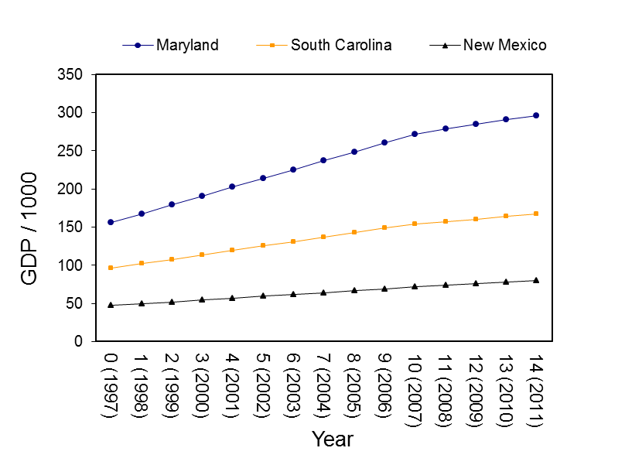
Step 6: Modeling Variability in Time-Based Parameters
Personal Income and State-Level variability in:
Pre-discontinuity slope (TIME)
Discontinuity (TRANS)
Post-discontinuity slope (RECOV)

Slide 140
Step 6: Modeling Variability in Time-Based Parameters
> mod6.b<-lme(gdp1k~TIME*pinc08.100k+
TRANS*pinc08.100k+RECOV*pinc08.100k,
random=~TIME+TRANS+RECOV|state, gdpdata.univ,
correlation=corAR1(form=~TIME|state),
control=list(opt="optim"))
> round(summary(mod6.b)$tTable,dig=4)
Value Std.Error DF t-value p-value
(Intercept) 4.0122 4.3978 708 0.9123 0.3619
TIME -0.8922 0.5077 708 -1.7574 0.0793
pinc08.100k 0.0638 0.0012 49 54.8118 0.0000
TRANS 1.5105 2.1745 708 0.6946 0.4875
RECOV 1.8000 1.1817 708 1.5232 0.1281
TIME:pinc08.100k 0.0048 0.0001 708 36.0762 0.0000
pinc08.100k:TRANS -0.0029 0.0006 708 -5.0823 0.0000
pinc08.100k:RECOV -0.0029 0.0003 708 -9.3703 0.0000

Slide 141
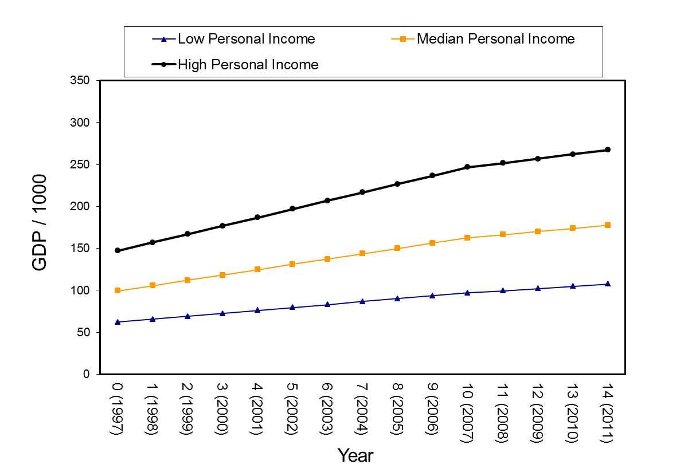
Step 6: Modeling Variability in Time-Based Parameters

Slide 142
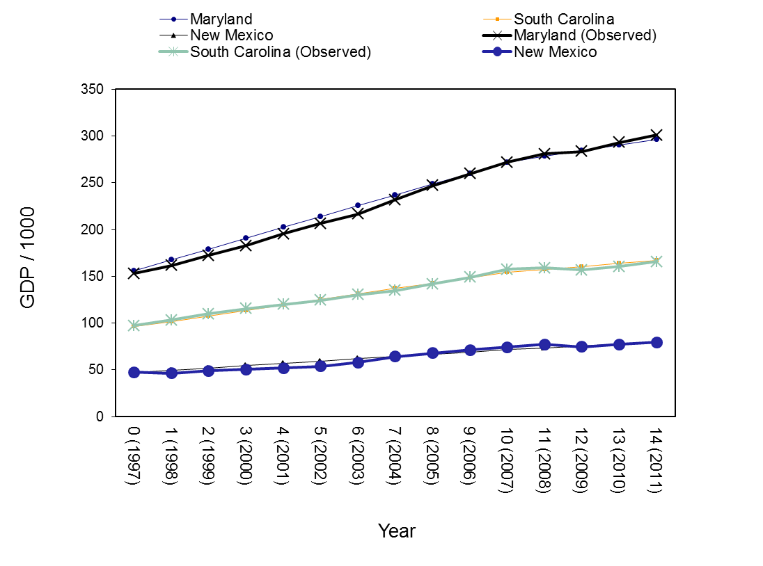
Step 6: Predicted Versus Observed

Slide 143
Examining Absolute Change
The t-tests in the current models provide tests of relative change:
Is the drop at the transition point significant relative to what would be expected
Is the recovery slope different than the pre-change slope
What if our theory expected absolute change
The transition will lead to a significant absolute decline
The post-transition slope will be negative

Slide 144
Create Time-Related Covariates
> gdpdata.univ$TIME.A<-ifelse(gdpdata.univ$TIME>=10,10,gdpdata.univ$TIME)
> gdpdata.univ[1:15,c("state","TIME","TIME.A","TRANS","RECOV")]
state TIME TIME.A TRANS RECOV
1 Alabama 0 0 0 0
1.1 Alabama 1 1 0 0
1.2 Alabama 2 2 0 0
1.3 Alabama 3 3 0 0
1.4 Alabama 4 4 0 0
1.5 Alabama 5 5 0 0
1.6 Alabama 6 6 0 0
1.7 Alabama 7 7 0 0
1.8 Alabama 8 8 0 0
1.9 Alabama 9 9 0 0
1.10 Alabama 10 10 0 0
1.11 Alabama 11 10 1 0
1.12 Alabama 12 10 1 1
1.13 Alabama 13 10 1 2
1.14 Alabama 14 10 1 3

Slide 145
Interpreting Step 2
> mod.abs<-lme(gdp1k~TIME.A+TRANS+RECOV,
random=~TIME+TRANS+RECOV|state,
gdpdata.univ,control=list(opt="optim"))
> round(summary(mod.abs)$tTable,dig=3)
Value Std.Error DF t-value p-value
(Intercept) 158.794 26.159 711 6.070 0.000
TIME.A 10.867 1.992 711 5.455 0.000
TRANS 5.368 2.130 711 2.520 0.012
RECOV 5.776 1.145 711 5.046 0.000
> mod.rel<-lme(gdp1k~TIME+TRANS+RECOV,
random=~TIME+TRANS+RECOV|state,
gdpdata.univ,control=list(opt="optim"))
> round(summary(mod.rel)$tTable,dig=3)
Value Std.Error DF t-value p-value
(Intercept) 158.794 26.159 711 6.070 0.000
TIME 10.867 1.992 711 5.455 0.000
TRANS -5.499 2.293 711 -2.398 0.017
RECOV -5.091 1.422 711 -3.580 0.000

Slide 146
Summary
Brief introduction to R and mixed-effect packages
Background on nested data and non-independence
Mixed-effects models for nested data
Examples of longitudinal (panel) data
Mixed-effects models for longitudinal data
Growth Model
Discontinuous Growth Model

Slide 147
Conclusion
Mixed-effect models are:
Well-accepted in psychology, education, some business school departments
Less known and less used in political science, economics.
For analysts working with data that contain some degree of non-independence (nested or longitudinal), the methods are potentially quite valuable.
Advances in R (e.g., lme4) make the methods more and more applicable to large and complex datasets.

